Slide 1
Lecture 3 Humans as Data Sources: Label Aggregation
Instructor: Chien-Ju (CJ) Ho

Slide 2
Logistics
Website: http://chienjuho.com/courses/cse518a
Piazza: http://piazza.com/wustl/fall2022/cse518a
Please follow the updates and announcements.
You are responsible for following the announcements/discussion made on the website and Piazza.

Slide 3
Logistics: Assignment 1
Amazon has been putting stronger restrictions on new accounts
For tax and data quality reasons
If you have a hard time getting the account:
Use other crowdsourcing platforms
Use your own judgements on what information to share
Be careful about potential scamming tasks (that ask you to give personal information or ask you to write fake reviews)
Borrow a MTurk account from others
You can complete the task but do NOT submit if you are worried about violations of ToS
Providing screenshots of the task interface is sufficient

Slide 4
Logistics: Paper Reviews
Submit your review for the “required reading” of each lecture
Submit via Gradescope
Due on 11:59pm the day before the lecture
There will be no reminders; make sure to do it before each lecture
Review questions
Common questions
Summarize the paper
List 2~3 points you like/dislike about the paper.
2 paper-specific questions
Reserve more time if you are not used to read research papers
Some papers are heavier (mathematically) than the others
Expect a very math-heavy reading next Tue.

Slide 5
Presentation and Leading of Discussion
Presentation requirements
Group presentation (2~3 persons per group)
I would expect a bit more from 3-person groups
By default, the same group will also work on the project together
Give a 50~55 min presentation based on the required reading and at least one optional reading (2 optional readings for 3-person groups) of a lecture.
The chosen papers are the “backbone” of the presentation. You are free to be creative and/or include materials outside of the papers
I’ll fill in the remaining time of the lecture
Prepare 2 reading questions for the required reading
Prepare 1~2 discussion sessions
Lead the discussion for the discussion sessions

Slide 6
Presentation and Leading of Discussion
Talk to me one week before your presentations
By default, stay after the lecture one week before your presentation
Or you can arrange other meeting time with me
You need to be ready for the following before meeting with me
A structure of your presentation
Two reading questions for the required reading
Topics for the discussion sessions
Finding teammates
Stay after the lectures to chat with others
The “Finding Teammate” feature is enabled on Piazza

Slide 7
Presentation and Leading of Discussion
Presentation topics
Check the course schedule for the labels [Presentation Slot #]
You will be asked to bid for lectures you are interested in presenting next Tuesday.
I’ll try to accommodate your preferences, but no guarantees on that
Each group will be assigned one lecture (in charge of 50~55 minutes of the lecture)
I’ll fill in the remaining lectures
The first two presentation slots will have relatively short amount of time to prepare. Please make sure you are fine with it

Slide 8
Project (done by groups)
Will talk more about this next week
Reminder on the tentative timeline
Sep 24: Project proposal
Brief description of the proposed project (1~2 paragraph)
Citing at least one paper that’s relevant to your proposal
Oct 15: Milestone 1
A brief literature review and the description of your plan (one page)
Last chance to change the topic of the project
Nov 5: Milestone 2
Summary of your current progress (up to 2 pages)
Last chance to convert the research project to (a more extensive) literature review
Dec 7/9: In-class project presentations
Dec 12: Project report due

Slide 9
Lecture Today

Slide 10
Course Overview
Human as data sources:
Label aggregation
Probabilistic reasoning to aggregate noisy human data
Practical challenges:
Real-time and complex tasks
Studies on workflow and team designs from HCI perspective
Humans are “Humans”:
Incentive design
Game theoretical modeling of humans and incentive design
Selected recent topics:
Ethical issues of AI/ML, learning with strategic behavior, Human-AI collaborations.

Slide 11
Course Overview
Human as data sources:
Label aggregation
Probabilistic reasoning to aggregate noisy human data
Practical challenges:
Real-time and complex tasks
Studies on workflow and team designs from HCI perspective
Humans are “Humans”:
Incentive design
Game theoretical modeling of humans and incentive design
Selected recent topics:
Ethical issues of AI/ML, learning with strategic behavior, Human-AI collaborations.

Slide 12
Today’s Lecture
Probability background on label aggregation
(Weighted) Majority Voting
Maximum likelihood estimation
Concentration bounds

Slide 13
Remember this task?
How many circles are in the image
These are the “labels” from you
256 | 649 | 900 | 1296
350 | 650 | 978 | 1500
375 | 700 | 1000 | 1700
387 | 720 | 1008 | 2000
455 | 730 | 1024 | 2100
494 | 739 | 1028 | 2500
519 | 800 | 1200 | 2500
550 | 800 | 1200 | 3000
625 | 847 | 1232 | 10,000
625 | 899 | 1250 | 102000
Mean: 3789.65
Median: 899.5
True Answer: 721
How to aggregate the answers?
Depend on how the labels are generated.

Slide 14
A Naïve Model of Label Generation
People have unbiased estimates of the true answer
user guess = true answer + Gaussian noise
If this model approximates the reality well, we can decide on aggregation
Mean of user guesses is an unbiased estimator for true answer
Observations
Latent values we want to know
Zero-Mean Noises

Slide 15
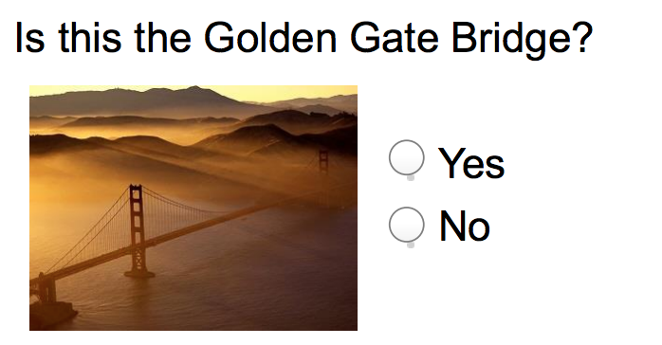
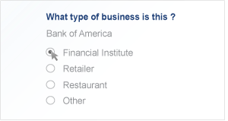
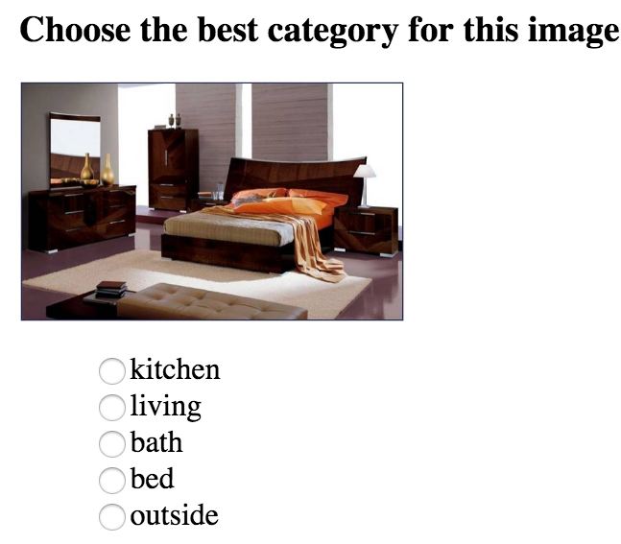
This Lecture Focuses on Binary Classification
Binary classification
Most techniques/results can be extended to multi-label case, though with more complicated details
Note
Guessing the Dots: regression problem
Aggregation in general space is hard/non-trivial (e.g., aggregating multiple transcriptions)

Slide 16
Defining Label Aggregation
Input
Output: Estimated task labels
Label aggregation is sometimes also called truth discovery
 | Worker 1 | Worker 2 | Worker 3 | Worker 4 | …
Task 1 | +1 | -1 |  | -1
Task 2 |  | -1 | +1
Task 3 | -1 |  |  | +1
Task 4 |  | +1 | +1
…

Slide 17
Warm-Up Discussion
{1,0} or {+1, -1} are two common choices of binary labels
We’ll use {+1,-1} for its mathematical convenience
Case 1: What’s your prediction of the true label of task 1? Why?
Case 2: What’s your prediction of the true label of task 2? Why?
What assumptions have you implicitly made in your arguments?
 | Worker 1 | Worker 2 | Worker 3 | Worker 4 | Worker 5
Task 1 | +1 | -1 | +1 | +1 | -1
 | True label | Worker 6 | Worker 7 | Worker 8 | Worker 9
Task 2 |  | +1 | -1 | +1 | -1
Task 3 | +1 | +1 | -1 | +1 | -1
Task 4 | +1 | -1 | +1 | -1 | +1
Task 5 | -1 | -1 | +1 | +1 | +1
Notes:
This lecture is going to be more mathematical.
Before going into math, let’s think about it intuitively

Slide 18
Majority Voting (MV)
Q1: Why MV might be a good idea?
Q2: Can we obtain theoretical guarantees for majority voting?
Understanding this simple scenario helps us develop aggregation methods for more complicated scenarios.

Slide 19
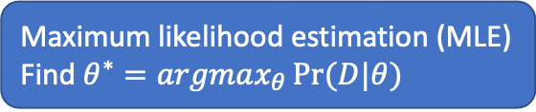
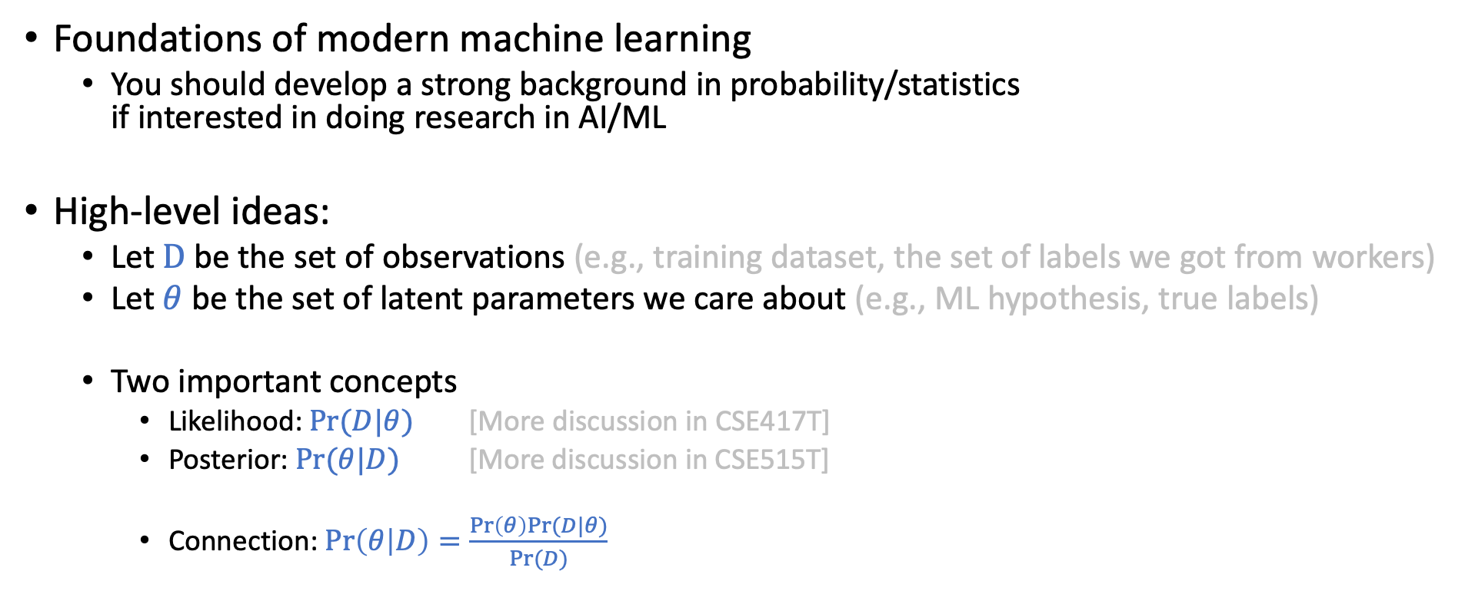
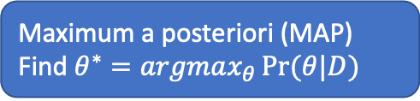
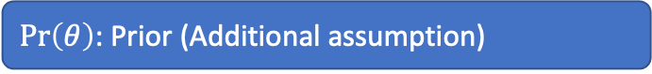
Probabilistic Approach
Foundations of modern machine learning
You should develop a strong background in probability/statistics if interested in doing research in AI/ML
High-level ideas:
Let $D$be the set of observations (e.g., training dataset, the set of labels we got from workers)
Let $θ$ be the set of latent parameters we care about (e.g., ML hypothesis, true labels)
Two important concepts
Likelihood: $Pr⁡(D|θ)$ [More discussion in CSE417T]
Posterior: $\operatorname{Pr}{(θ|D)}$ [More discussion in CSE515T]
Connection: $\operatorname{Pr}\left(θ | D\right)=\frac{\operatorname{Pr}\left(θ\right)Pr⁡(D|θ)}{Pr⁡(D)}$
Maximum likelihood estimation (MLE)
Find $θ^{∗}=argmax_{θ}\operatorname{Pr}{(D|θ)}$
Maximum a posteriori (MAP)
Find $θ^{∗}=argmax_{θ}\operatorname{Pr}{(θ|D)}$
$\operatorname{Pr}\left(θ\right)$: Prior (Additional assumption)

Slide 20
Why Majority Voting?
 | Worker 1 | Worker 2 | Worker 3 | Worker 4 | Worker 5
Task 1 | +1 | -1 | +1 | +1 | -1
Majority voting leads to maximum likelihood estimation

Slide 21
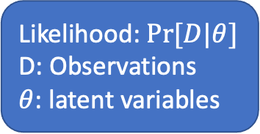
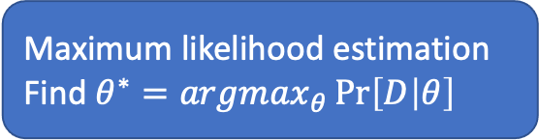
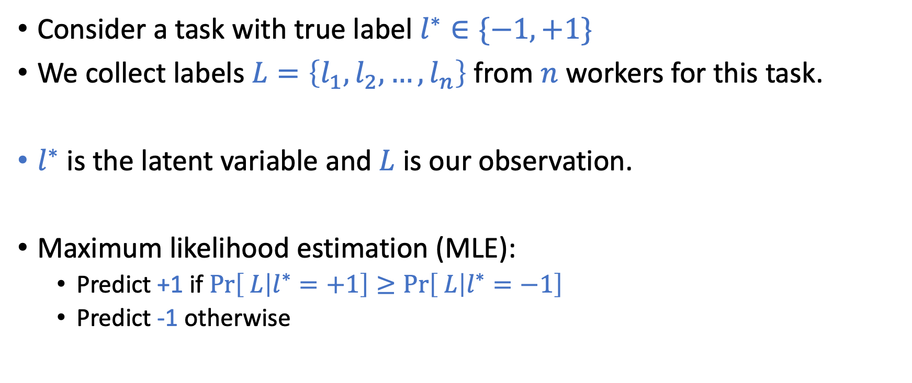
Formulation
 | Worker 1 | Worker 2 | Worker 3 | Worker 4 | Worker 5
Task 1 | +1 | -1 | +1 | +1 | -1
Consider a task with true label $l^{∗}∈\{−1,+1\}$
We collect labels $L=\left\{l_{1},l_{2},…,l_{n}\right\}$ from $n$ workers for this task.
Each worker gives the correct label with probability $p>0.5$.
$l^{∗}$ is the latent variable and $L$ is our observation.
Maximum likelihood estimation (MLE):
Predict +1 if $\operatorname{Pr}\left[ L | l^{∗}=+1\right]≥\operatorname{Pr}\left[ L | l^{∗}=−1\right]$
Predict -1 otherwise
Likelihood: $Pr⁡[D|θ]$
D: Observations
$θ$: latent variables
Maximum likelihood estimation
Find $θ^{∗}=argmax_{θ}\operatorname{Pr}\left[D | θ\right]$
It requires models/assumptions to calculate

Slide 22
How should we model the label generation process?

Slide 23
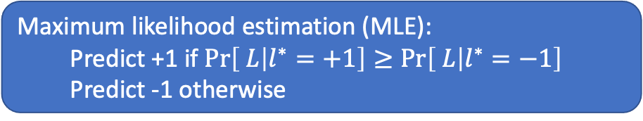
A Simple Model for Case 1
 | Worker 1 | Worker 2 | Worker 3 | Worker 4 | Worker 5
Task 1 | +1 | -1 | +1 | +1 | -1
Maximum likelihood estimation (MLE):
Predict +1 if $\operatorname{Pr}\left[ L | l^{∗}=+1\right]≥\operatorname{Pr}\left[ L | l^{∗}=−1\right]$
Predict -1 otherwise
Assumption:
Each worker gives a label in a probabilistic manner
Each worker has the same ability of giving correct labels
Each worker gives a label on his/her own
Each worker is more likely to provide a correct label than a wrong label
Model
Each worker gives the correct label independently with probability p > 0.5
Given no additional information, this is close to the best you can model

Slide 24
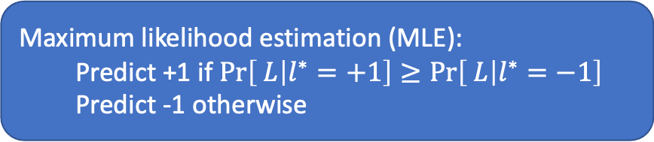
Derivation of MLE ⬄ MV
Maximum likelihood estimation (MLE):
Predict +1 if $\operatorname{Pr}\left[ L | l^{∗}=+1\right]≥\operatorname{Pr}\left[ L | l^{∗}=−1\right]$
Predict -1 otherwise
Model: Each worker gives the correct label independently with probability p > 0.5
Key assumption: independent worker labels

Slide 25
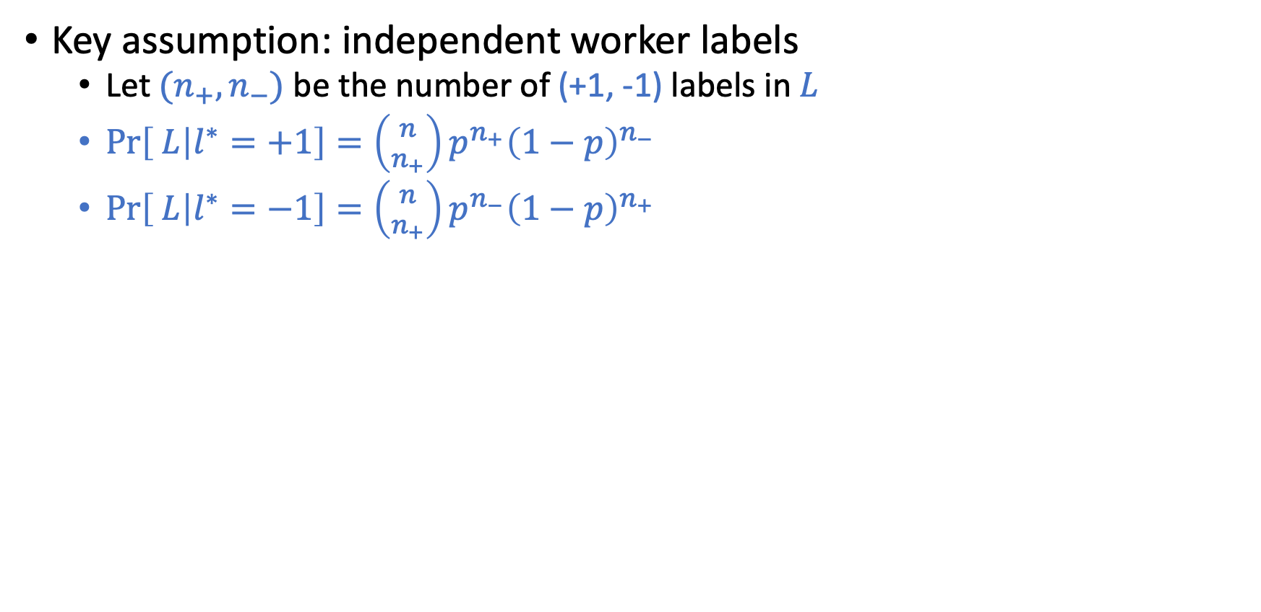
Derivation of MLE ⬄ MV
Maximum likelihood estimation (MLE):
Predict +1 if $\operatorname{Pr}\left[ L | l^{∗}=+1\right]≥\operatorname{Pr}\left[ L | l^{∗}=−1\right]$
Predict -1 otherwise
Model: Each worker gives the correct label independently with probability p > 0.5
Key assumption: independent worker labels
Let ${(n}_{+},n_{−})$ be the number of (+1, -1) labels in $L$
$\operatorname{Pr}\left[ L | l^{∗}=+1\right]={\left({n \atop n_{+}}\right)p}^{n_{+}}{\left(1−p\right)}^{n_{−}}$
$\operatorname{Pr}\left[ L | l^{∗}=−1\right]={\left({n \atop n_{+}}\right)p}^{n_{−}}{\left(1−p\right)}^{n_{+}}$
MLE rule is equivalent to
Predict +1 if $\ln{\frac{p^{n_{+}}{\left(1−p\right)}^{n_{−}}}{p^{n_{−}}{\left(1−p\right)}^{n_{+}}}}≥0$
Predict +1 if $\left(n_{+}−n_{−}\right)\left(\ln{p}−\ln\left(1−p\right)\right)≥0$
Predict +1 if $n_{+}≥n_{−}$
This is majority voting

Slide 26
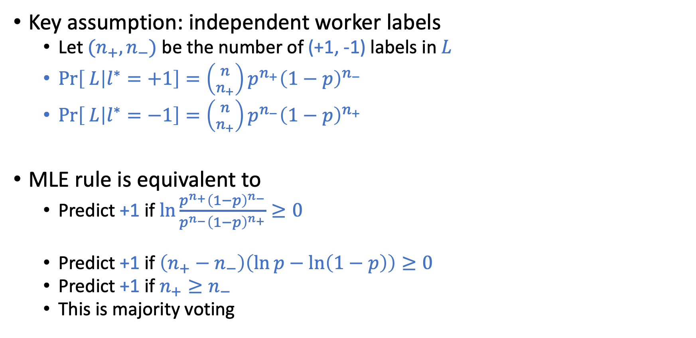
Derivation of MLE ⬄ MV
Maximum likelihood estimation (MLE):
Predict +1 if $\operatorname{Pr}\left[ L | l^{∗}=+1\right]≥\operatorname{Pr}\left[ L | l^{∗}=−1\right]$
Predict -1 otherwise
Model: Each worker gives the correct label independently with probability p > 0.5
Key assumption: independent worker labels
Let ${(n}_{+},n_{−})$ be the number of (+1, -1) labels in $L$
$\operatorname{Pr}\left[ L | l^{∗}=+1\right]={\left({n \atop n_{+}}\right)p}^{n_{+}}{\left(1−p\right)}^{n_{−}}$
$\operatorname{Pr}\left[ L | l^{∗}=−1\right]={\left({n \atop n_{+}}\right)p}^{n_{−}}{\left(1−p\right)}^{n_{+}}$
MLE rule is equivalent to
Predict +1 if $\ln{\frac{p^{n_{+}}{\left(1−p\right)}^{n_{−}}}{p^{n_{−}}{\left(1−p\right)}^{n_{+}}}}≥0$
Predict +1 if $\left(n_{+}−n_{−}\right)\left(\ln{p}−\ln\left(1−p\right)\right)≥0$
Predict +1 if $n_{+}≥n_{−}$
This is majority voting

Slide 27
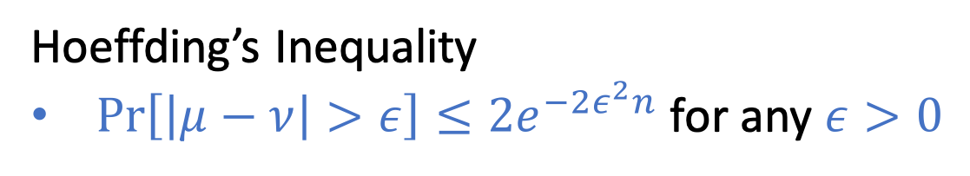
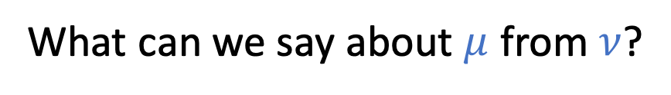
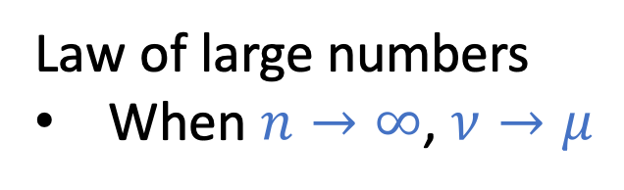
What theoretical guarantee can MV achieve?
Consider a thought experiment
What can we say about $μ$ from $ν$?
Draw with replacement
Law of large numbers
When $n→∞$, $ν→μ$
Hoeffding’s Inequality
$\operatorname{Pr}\left[\left|μ−ν\right|>ε\right]≤2e^{−2ε^{2}n}$ for any $ε>0$
n: number of samples

Slide 28
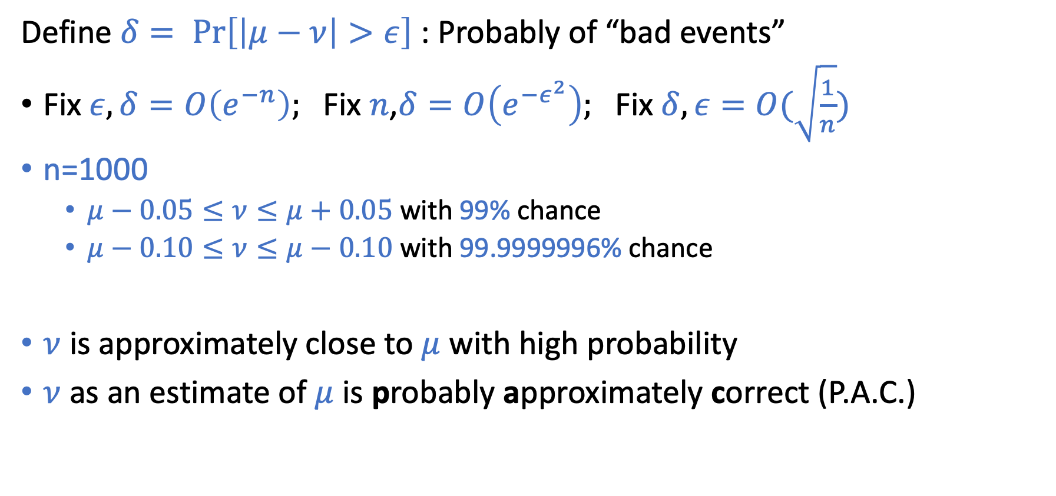
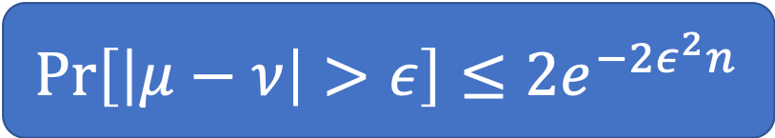
Interpretations
$$\operatorname{Pr}\left[\left|μ−ν\right|>ε\right]≤2e^{−2ε^{2}n}$$
Define $δ= \operatorname{Pr}\left[\left|μ−ν\right|>ε\right]$ : Probably of “bad events”
Fix $ε, δ=O\left(e^{−n}\right);$Fix $n$,$δ=O\left(e^{−ε^{2}}\right);$Fix $δ, ε=O(\sqrt{\frac{1}{n}})$
n=1000
$μ−0.05≤ν≤μ+0.05$ with 99% chance
$μ−0.10≤ν≤μ−0.10$ with 99.9999996% chance
$ν$ is approximately close to $μ$ with high probability
$ν$ as an estimate of $μ$ is probably approximately correct (P.A.C.)
PAC learning is proposed by Leslie Valiant, who wins the Turing award in 2010.

Slide 29
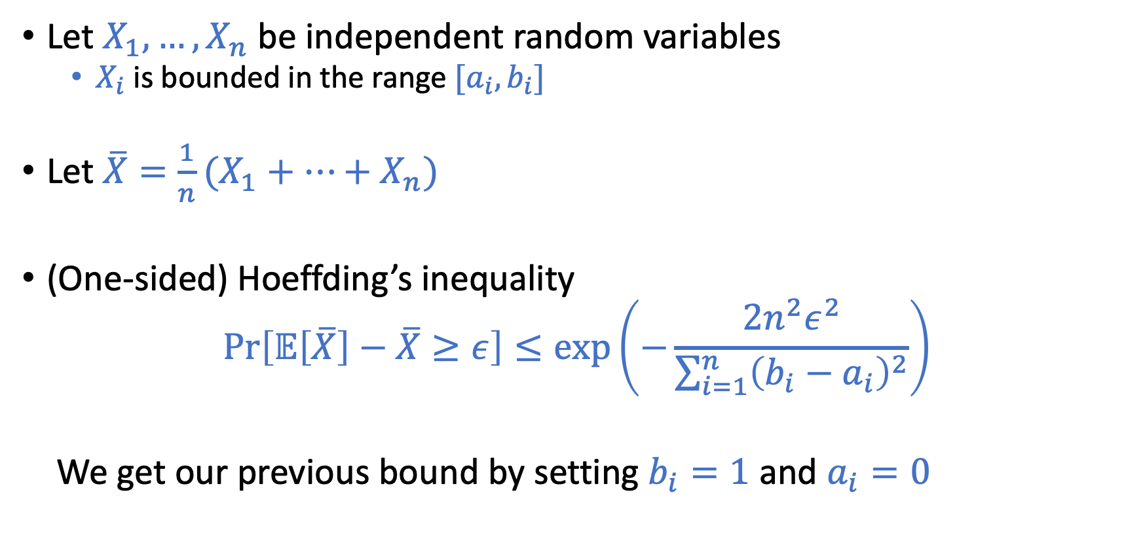
More general form of Hoeffding’s inequality
Let $X_{1},…,X_{n}$ be independent random variables
$X_{i}$ is bounded in the range $[a_{i}, b_{i}]$
Let $\overline{X}=\frac{1}{n}(X_{1}+…+X_{n})$
(One-sided) Hoeffding’s inequality
$$\operatorname{Pr}\left[𝔼\left[\overline{X}\right]−\overline{X}≥ε\right]≤\exp\left(−\frac{2n^{2}ε^{2}}{\sum_{i=1}^{n}{{\left(b_{i}−a_{i}\right)}^{2}}}\right)$$
We get our previous bound by setting $b_{i}=1$ and $a_{i}=0$

Slide 30
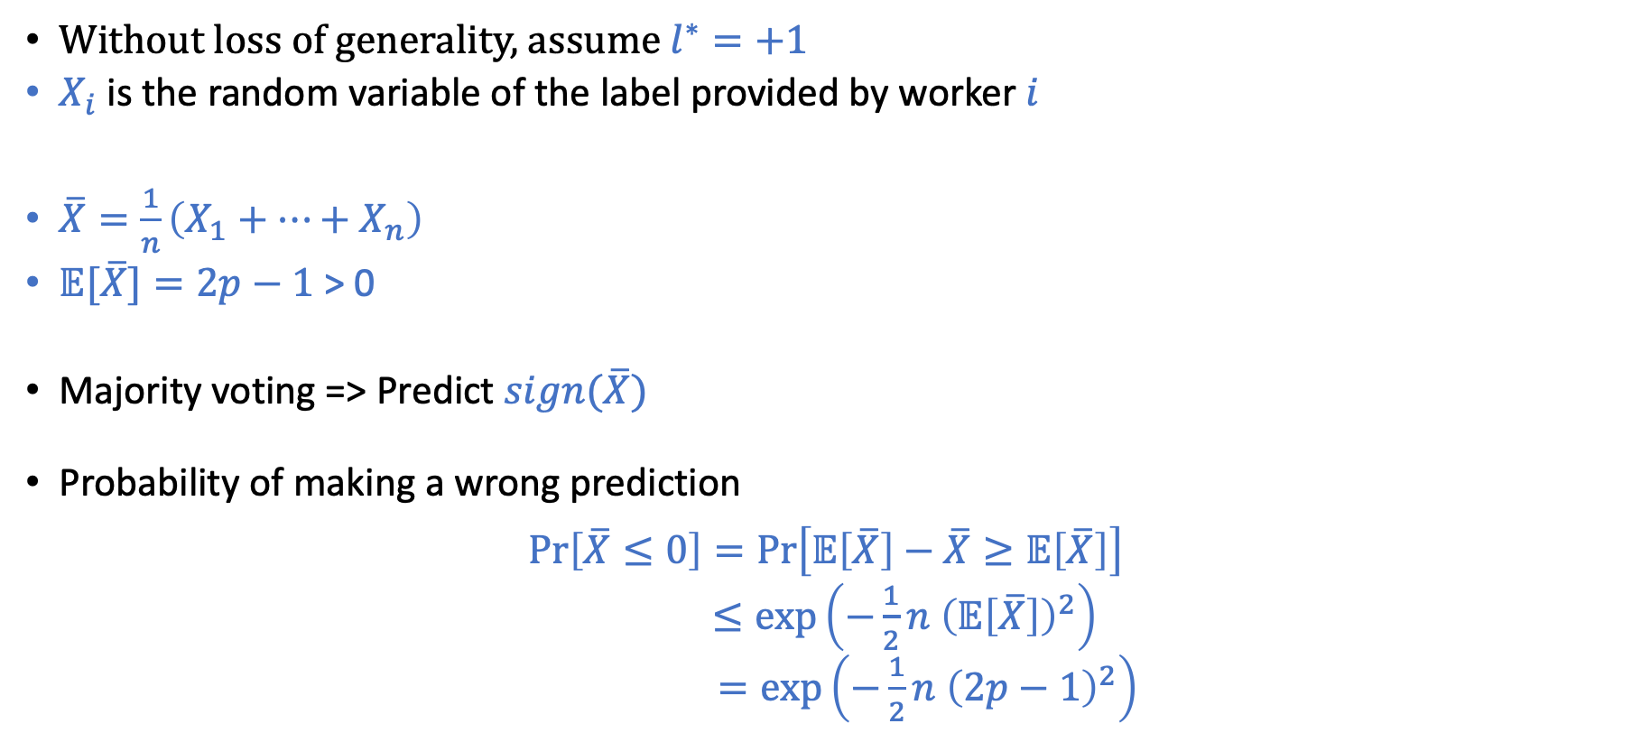
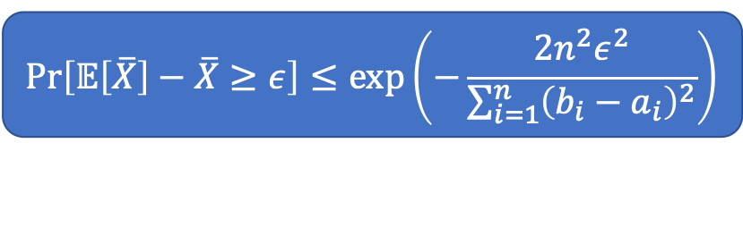
Connection to Our Problem
$$\operatorname{Pr}\left[𝔼\left[\overline{X}\right]−\overline{X}≥ε\right]≤\exp\left(−\frac{2n^{2}ε^{2}}{\sum_{i=1}^{n}{{\left(b_{i}−a_{i}\right)}^{2}}}\right)$$
Without loss of generality, assume $l^{∗}=+1$
$X_{i}$ is the random variable of the label provided by worker $i$
$\overline{X}=\frac{1}{n}\left(X_{1}+…+X_{n}\right)$
$𝔼[\overline{X}]=2p−1$ > 0
Majority voting => Predict $sign(\overline{X})$
Probability of making a wrong prediction
$$\operatorname{Pr}\left[\overline{X}≤0\right]=\operatorname{Pr}\left[𝔼\left[\overline{X}\right]−\overline{X}≥𝔼\left[\overline{X}\right]\right]$$
$≤\exp\left(−\frac{1}{2}n {\left(𝔼\left[\overline{X}\right]\right)}^{2}\right)$
$=\exp\left(−\frac{1}{2}n {\left(2p−1\right)}^{2}\right)$

Slide 31
Looks like we solved the problem?
only if we assume all workers are the same….
 | True label | Worker 6 | Worker 7 | Worker 8 | Worker 9
Task 2 |  | +1 | -1 | +1 | -1
Task 3 | +1 | +1 | -1 | +1 | -1
Task 4 | +1 | -1 | +1 | -1 | +1
Task 5 | -1 | -1 | +1 | +1 | +1

Slide 32
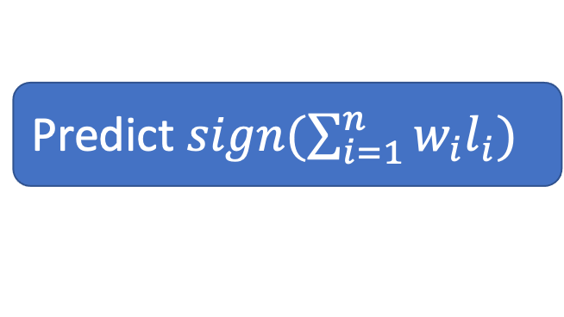
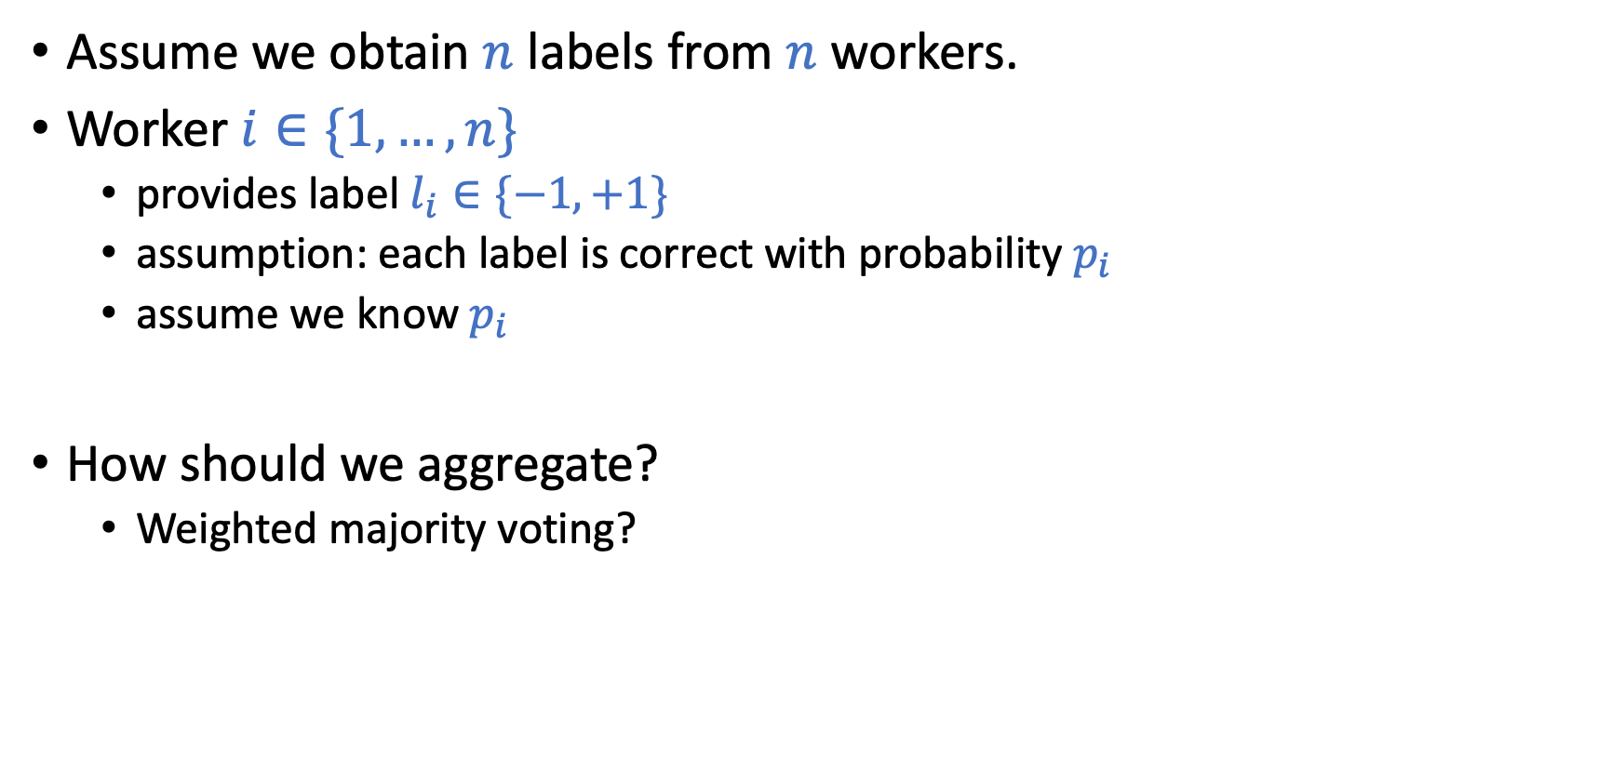
What happens if workers are different
Assume we obtain $n$ labels from $n$workers.
Worker $i∈\{1,…,n\}$
provides label $l_{i}∈\{−1,+1\}$
assumption: each label is correct with probability $p_{i}$
assume we know $p_{i}$
How should we aggregate?
Weighted majority voting?
Predict $sign(\sum_{i=1}^{n}{w_{i}l_{i}})$

Slide 33
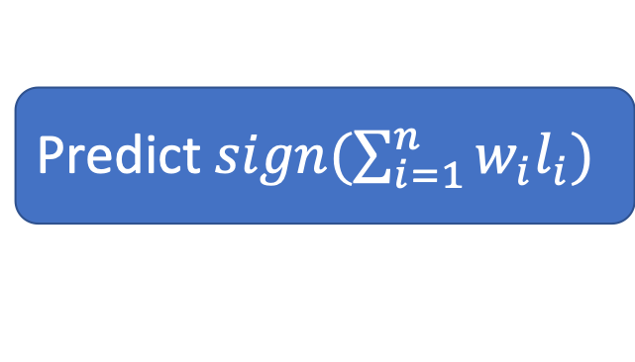
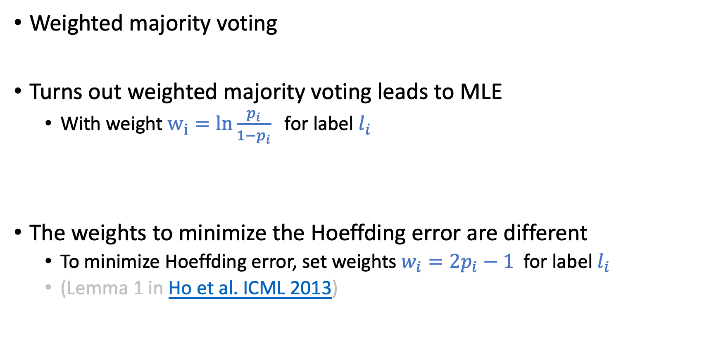
Weighted Majority Voting
Predict $sign(\sum_{i=1}^{n}{w_{i}l_{i}})$
Weighted majority voting
Turns out weighted majority voting leads to MLE
With weight $w_{i}=ln{\frac{p_{i}}{1−p_{i}}}$ for label $l_{i}$
The weights to minimize the Hoeffding error are different
To minimize Hoeffding error, set weights $w_{i}=2p_{i}−1$ for label $l_{i}$
(Lemma 1 in Ho et al. ICML 2013)

Slide 34
For the next two lectures
 | True label | Worker 6 | Worker 7 | Worker 8 | Worker 9
Task 2 |  | +1 | -1 | +1 | -1
Task 3 |  | +1 | -1 | +1 | -1
Task 4 |  | -1 | +1 | -1 | +1
Task 5 |  | -1 | +1 | +1 | +1
Unknown worker skills
Different task difficulties
More factors to consider (some structures of tasks/workers?)
…

Slide 35
Typical label aggregation approach
Propose a model to describe the label generation process
True labels are the “latent variables” of the process
Using inference algorithms (e.g., EM) to learn the latent variables
Write down likelihood/posterior function
Using EM algorithms to find the parameters
that maximize likelihood/posterior
Write labels as a matrix (worker by task)
Using low rank matrix approximation

Slide 36
Discussion
Do you think the models we made so far make sense? Why? Under what conditions can our model break? What can we do to address those conditions?
Can you think of other important aspects (at least in some applications) that should be modeled?
Take this time to find your potential teammates!

